Slide 1
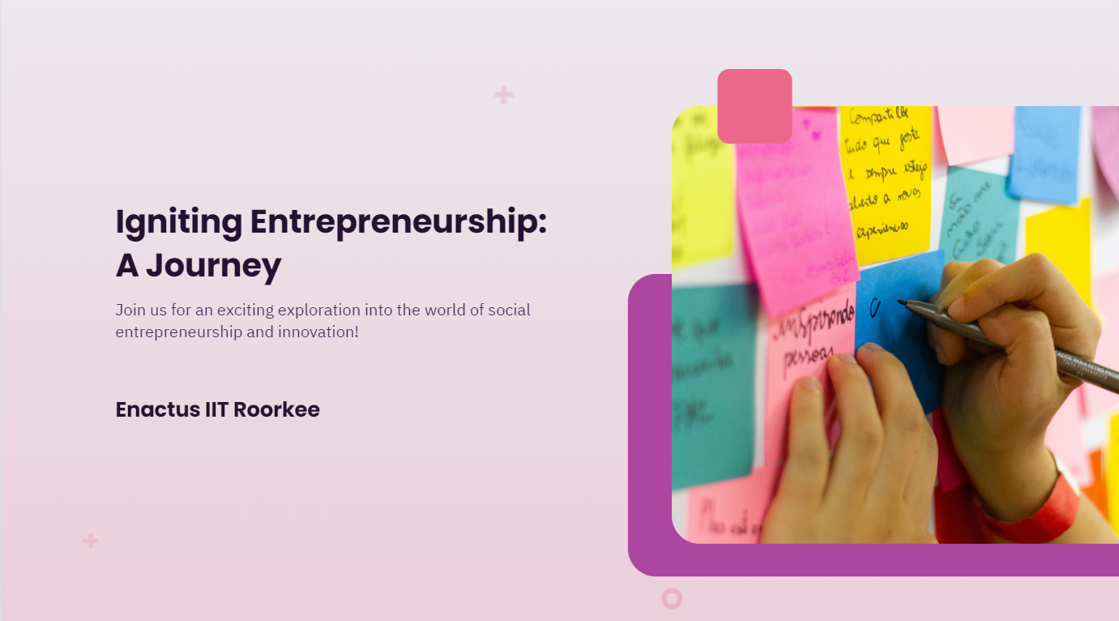

Slide 2
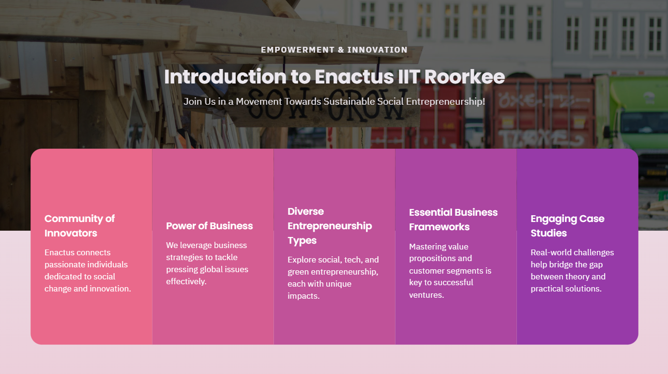

Slide 3
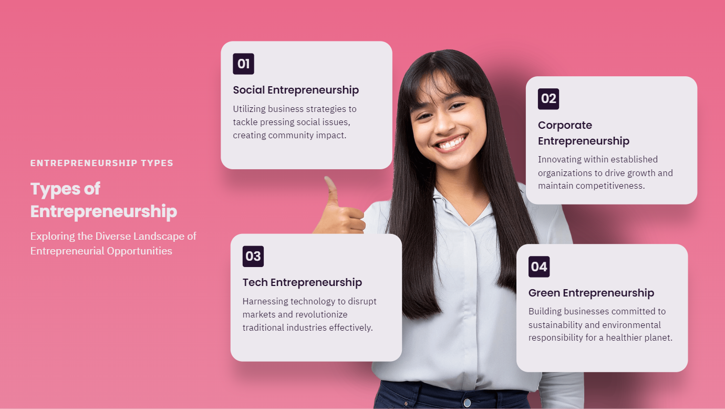

Slide 4
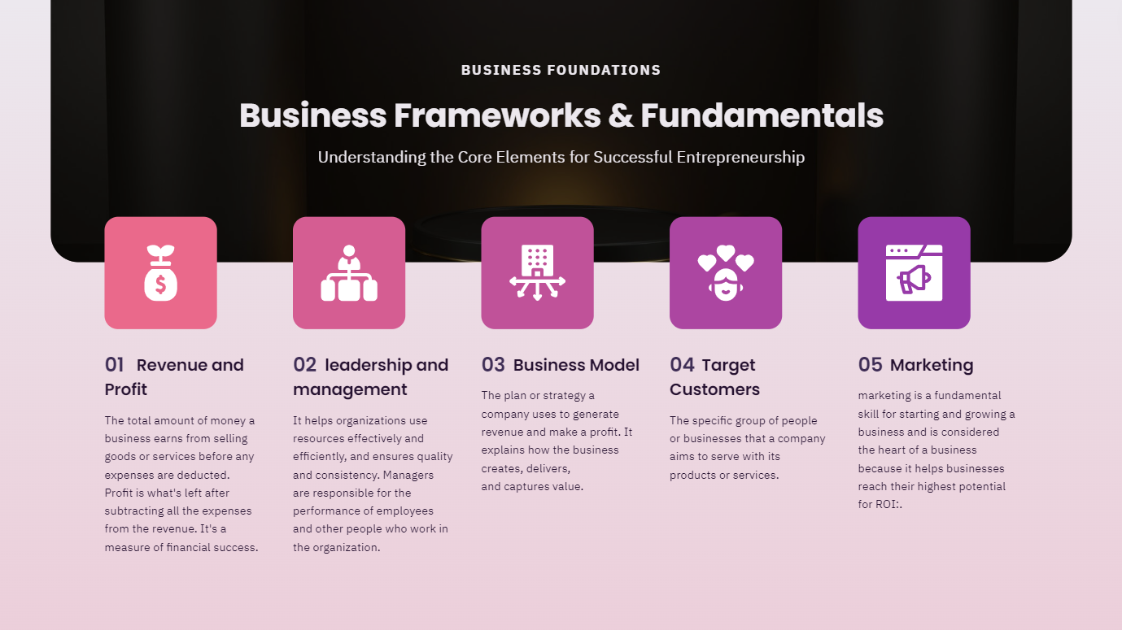

Slide 5
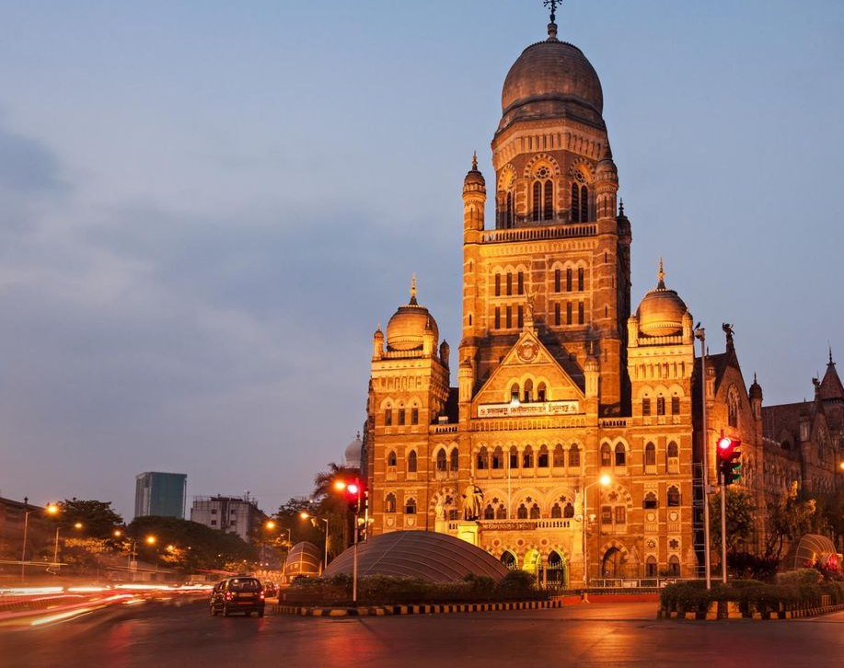
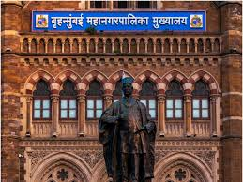
BMC!?

Slide 7
Business Model Canvas
What Activities and Resources are important but not aligned with what’s uniquely strategy for you?
What’s outside of your business type?
Could partners do some of those? Why? Which?
What specific key activities are necessary to deliver our value proposition? What activities set our company apart from others?
Production, Problem Solving, Platform/Network
What value do we deliver to the customer?
Which one of our customer’s problems are we helping to solve?
What is unique about our Value Propositions and why does your customer prefer them to their Current Alternatives?
How does the customer interact with you through the sales and product lifecycle?
Can the Value Proposition be delivered to the Customer this way?
Is there a premium support product you need to create?
Identify who is our value proposition targets.
Who are our most important customers?
What are they like?
What do they need?
What do they enjoy?
Key Partners
Key Activities
Value Propositions
Customer Relationship
Customer Segments
What Key Resources do our Value Propositions require? Our Distribution Channels? Customer Relationships Revenue Streams?
Physical, Intellectual (brand patents, copyrights, data), Human, Financial
How do we deliver our value proposition?
How are we reaching them now?
How are our Channels integrated?
Which ones work best?
Which ones are most cost-efficient?
Key Resources
Channels
What are the most important costs inherent in our business model?
Which Key Resources are most expensive?
Which Key Activities are most expensive?
For what value are our customers really willing to pay?
For what do they currently pay?
How are they currently paying? How would they prefer to pay?
How much does each Revenue Stream contribute to overall revenues?
Cost Structure
Revenue Stream

Slide 8
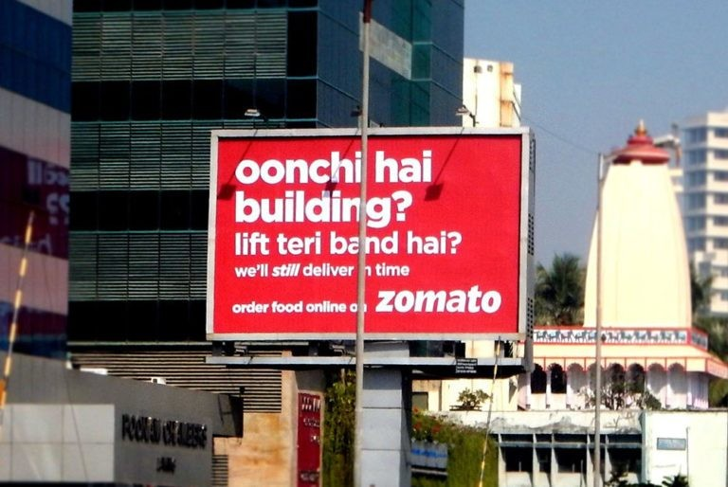

Slide 9
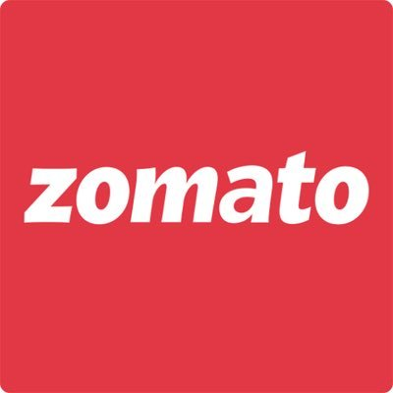
Business Model Canvas
Food Lovers
Busy Professionals
Restaurant owners
Key Partners
Key Activities
Value Propositions
Customer Relationship
Customer Segments
Key Resources
Channels
Cost Structure
Revenue Stream

Slide 10
Business Model Canvas
Convenience
Variety: Access to a vast selection of restaurants.
Quality
Transparency: Detailed information about restaurants and menu items.
Delivery and pickup
Reviews and ratings
Food Lovers
Busy Professionals
Restaurant owners
Key Partners
Key Activities
Value Propositions
Customer Relationship
Customer Segments
Key Resources
Channels
Cost Structure
Revenue Stream

Slide 11
Business Model Canvas
Convenience
Variety: Access to a vast selection of restaurants.
Quality
Transparency: Detailed information about restaurants and menu items.
Delivery and pickup
Reviews and ratings
Food Lovers
Busy Professionals
Restaurant owners
Key Partners
Key Activities
Value Propositions
Customer Relationship
Customer Segments
Website
Mobile app
Social Media
Key Resources
Channels
Cost Structure
Revenue Stream

Slide 12
Business Model Canvas
Convenience
Variety: Access to a vast selection of restaurants.
Quality
Transparency: Detailed information about restaurants and menu items.
Delivery and pickup
Reviews and ratings
Customer Support
Rewards and incentives
Personalized Recommendations
User Feedback
Food Lovers
Busy Professionals
Restaurant owners
Key Partners
Key Activities
Value Propositions
Customer Relationship
Customer Segments
Website
Mobile app
Social Media
Key Resources
Channels
Cost Structure
Revenue Stream

Slide 13
Business Model Canvas
Convenience
Variety: Access to a vast selection of restaurants.
Quality
Transparency: Detailed information about restaurants and menu items.
Delivery and pickup
Reviews and ratings
Customer Support
Rewards and incentives
Personalized Recommendations
User Feedback
Food Lovers
Busy Professionals
Restaurant owners
Key Partners
Key Activities
Value Propositions
Customer Relationship
Customer Segments
Website
Mobile app
Social Media
Key Resources
Channels
Commission on orders
Advertisements displayed on the app and website
Subscription services
Cost Structure
Revenue Stream

Slide 14
Business Model Canvas
Restaurant onboarding
Order Processing
Marketing and Promotion
Data Analysis
Delivery Management
Customer Support
Convenience
Variety: Access to a vast selection of restaurants.
Quality
Transparency: Detailed information about restaurants and menu items.
Delivery and pickup
Reviews and ratings
Customer Support
Rewards and incentives
Personalized Recommendations
User Feedback
Food Lovers
Busy Professionals
Restaurant owners
Key Partners
Key Activities
Value Propositions
Customer Relationship
Customer Segments
Website
Mobile app
Social Media
Key Resources
Channels
Commission on orders
Advertisements displayed on the app and website
Subscription services
Cost Structure
Revenue Stream

Slide 15
Business Model Canvas
Restaurant onboarding
Order Processing
Marketing and Promotion
Data Analysis
Delivery Management
Customer Support
Convenience
Variety: Access to a vast selection of restaurants.
Quality
Transparency: Detailed information about restaurants and menu items.
Delivery and pickup
Reviews and ratings
Customer Support
Rewards and incentives
Personalized Recommendations
User Feedback
Food Lovers
Busy Professionals
Restaurant owners
Key Partners
Key Activities
Value Propositions
Customer Relationship
Customer Segments
Technology Platform
Delivery Network
Restaurant partnerships
Data and Analytics
Website
Mobile app
Social Media
Key Resources
Channels
Commission on orders
Advertisements displayed on the app and website
Subscription services
Cost Structure
Revenue Stream

Slide 16
Business Model Canvas
Restaurants
Delivery Partners
Technology Providers
Marketing Partners
Payment gateways
Restaurant onboarding
Order Processing
Marketing and Promotion
Data Analysis
Delivery Management
Customer Support
Convenience
Variety: Access to a vast selection of restaurants.
Quality
Transparency: Detailed information about restaurants and menu items.
Delivery and pickup
Reviews and ratings
Customer Support
Rewards and incentives
Personalized Recommendations
User Feedback
Food Lovers
Busy Professionals
Restaurant owners
Key Partners
Key Activities
Value Propositions
Customer Relationship
Customer Segments
Technology Platform
Delivery Network
Restaurant partnerships
Data and Analytics
Website
Mobile app
Social Media
Key Resources
Channels
Commission on orders
Advertisements displayed on the app and website
Subscription services
Cost Structure
Revenue Stream

Slide 17
Business Model Canvas
Restaurants
Delivery Partners
Technology Providers
Marketing Partners
Payment gateways
Restaurant onboarding
Order Processing
Marketing and Promotion
Data Analysis
Delivery Management
Customer Support
Convenience
Variety: Access to a vast selection of restaurants.
Quality
Transparency: Detailed information about restaurants and menu items.
Delivery and pickup
Reviews and ratings
Customer Support
Rewards and incentives
Personalized Recommendations
User Feedback
Food Lovers
Busy Professionals
Restaurant owners
Key Partners
Key Activities
Value Propositions
Customer Relationship
Customer Segments
Technology Platform
Delivery Network
Restaurant partnerships
Data and Analytics
Website
Mobile app
Social Media
Key Resources
Channels
Technology costs
Marketing and advertising costs
Delivery costs
Customer support costs
Commission on orders
Advertisements displayed on the app and website
Subscription services
Cost Structure
Revenue Stream

Slide 18
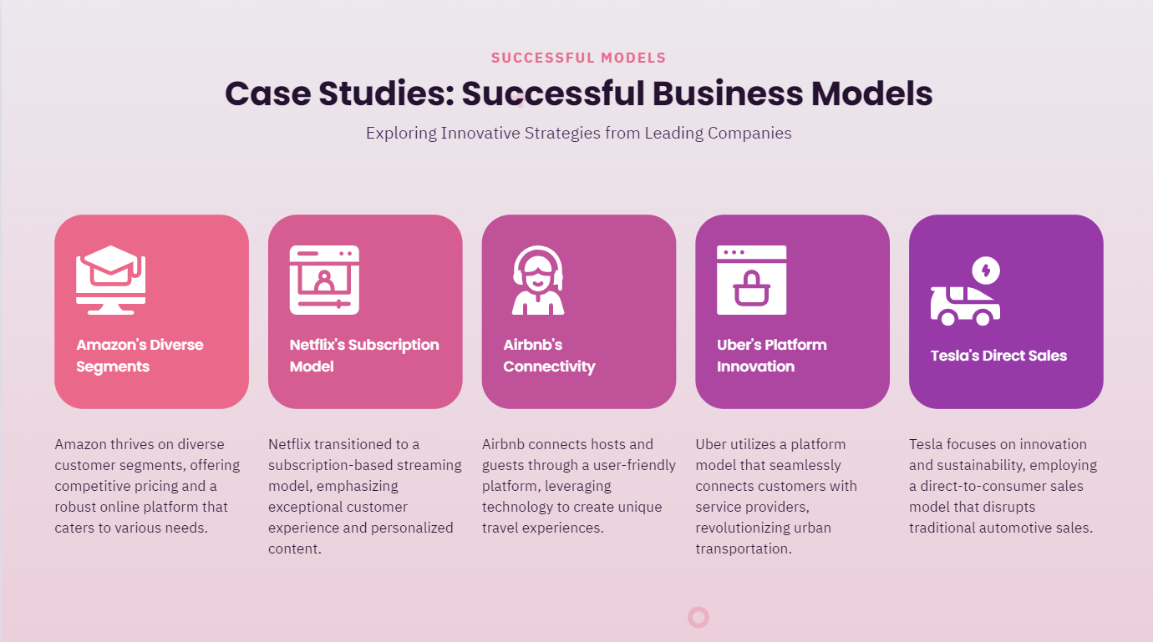

Slide 19



CASE STUDY
MYNTRA
“MYNTRA’s entry into fashion quick commerce”

Slide 20



About Myntra
Market Position: Leading Indian platform for fashion, footwear, accessories, and home decor.
Customer Base: Focus on young, fashion-conscious consumers; strong digital and social media presence.

Slide 21


Market Size: The quick commerce market in India is projected to reach USD 5.5 billion by 2025
Growth Rate: The sector is expected to grow at a CAGR of 25-30%

Slide 22



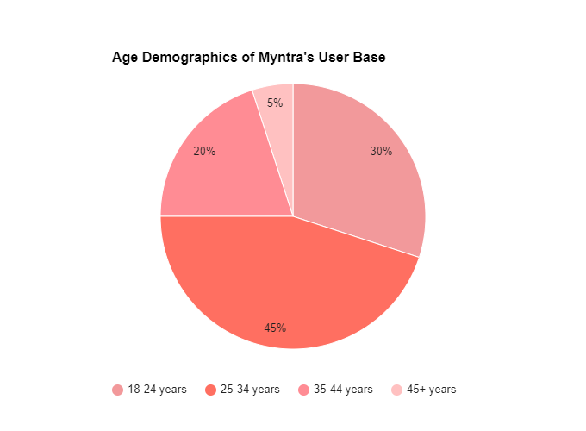
Target Audience and Consumer Behavior
Myntra's Customer Base Alignment
18-24 years: Students and young professionals
25-34 years: Mid-career professionals
35-44 years: Established professionals,
45+ years: Less frequent users
Myntra's Customer Base Alignment
Young Demographic
Urban Focus
Tech-Savvy
Convenience-Oriented.
Brand Loyalty

Slide 23

Competitor Analysis
Competitor | Strategies
Zepto | Dark stores, rapid delivery, expansion, fashion integration.
Blinkit | Diversification, fast delivery, lifestyle, electronics.
Dunzo | Group deliveries, financial challenges, pause expansion.
Amazon Fresh | logistics, fashion offerings.
BigBasket | Quick delivery, non-grocery items, fashion.
Flipkart | Flipkart minutes,dark stores,same day delivery
Amazon | AI integration,global expansion,mobile shopping,sustainability,social commerce
Ajio | Non-Metro Market Penetration,focus on premiumization

Slide 24



Strategic Positioning of Myntra in Quick Commerce
How Myntra Can Differentiate Itself
Fashion Focus:
60% of quick commerce users are interested in fashion and lifestyle products
Brand Partnerships:
Myntra has over 100 premium brands onboard.
Personalized Experience:
75% of consumers prefer personalized shopping experiences
Synergies with Myntra’s Existing Business Model:
Leveraging Existing Infrastructure:
Cross-Selling Opportunities:
.
Customer Insights:
Brand Loyalty:

Slide 25

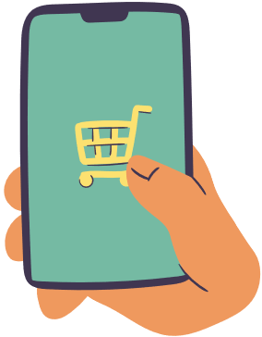

Product and Service Offerings
Types of Products to be Offered:
Fashion Essentials
Beauty Products
Lifestyle Products
Integration with Myntra's
Existing App and Platform:
Enhanced User Interface
Unified Loyalty Program
Cross-Functional Integration
Unified Customer Accounts
Customer Service Strategy:
24/7 Support
Real-Time Tracking:
Feedback and Returns:

Slide 26




Inventory Management
01
Demand Forecasting:
Historical data, seasonal trends, real-time analytics, supplier collaboration.
02
Warehouse Management:
Distributed warehousing, strategic locations, warehouse automation, quick turnaround.
03
Technology Integration:
Inventory management systems, automation, demand forecasting, system integration (order management, CRM).
I
04
Inventory Optimization:
Just-in-time inventory, reduce holding costs, minimize waste, safety stock, demand spikes, supply chain disruptions.
.

Slide 27




Go-to-Market Strategy for Myntra’s Quick Commerce
Market Research and Analysis:
Conduct Surveys
Analyze Competitors
Positioning and Branding:
USP
Marketing and Promotional Strategies:
Digital Ads
Influencer Marketing
Promotion
Strategic Partnerships:
Retailer
Tech

Slide 28
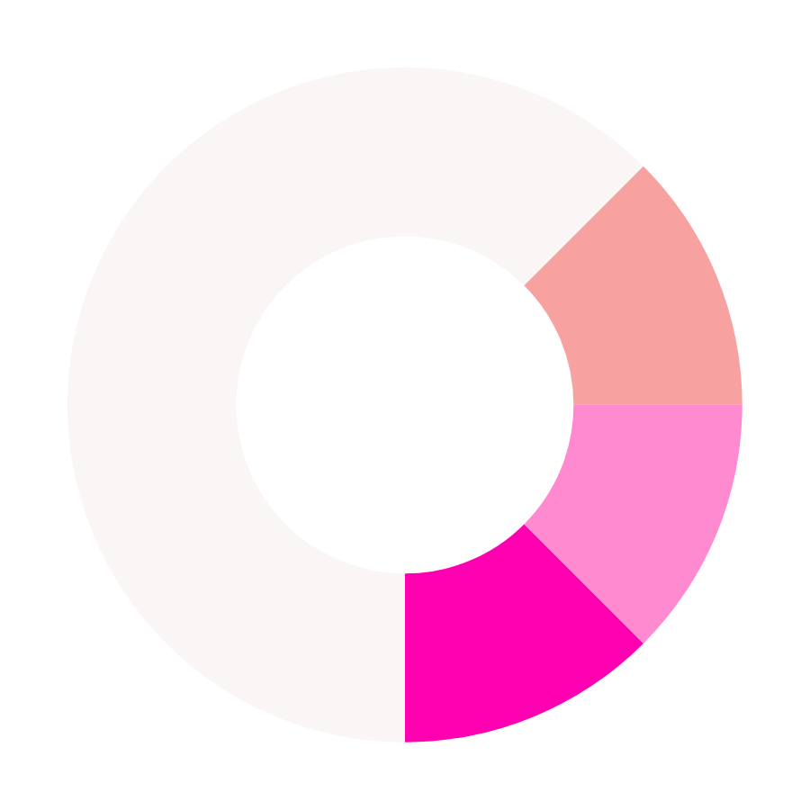






Porter’s Forces
Threat of New Entrants : focus on convenience, speed, and price
01
Threat of Substitutes : Traditional retail, e-commerce, local shopping, convenience, high costs.
02
Bargaining Power of Buyers : Price sensitivity, low switching costs, speed, brand loyalty.
03
04
Bargaining Power of Suppliers : Market fragmentation, scale leverage, logistics, tiered procurement.

Slide 29
Risk and Mitigation
Potential Risk | Mitigation Strategy
Intense Competition | Differentiate, unique offerings, superior service.
Operational Challenges | Invest in technology, optimize logistics.
Customer Acquisition Costs | Targeted marketing, leverage customer base.
Regulatory Compliance | Stay updated, ensure compliance.
Customer Retention | Personalized offers, loyalty programs.
Supply Chain Disruptions | Multiple suppliers, buffer stock.
Economic Downturn | Value-driven promotions, diversify offerings.

Slide 30
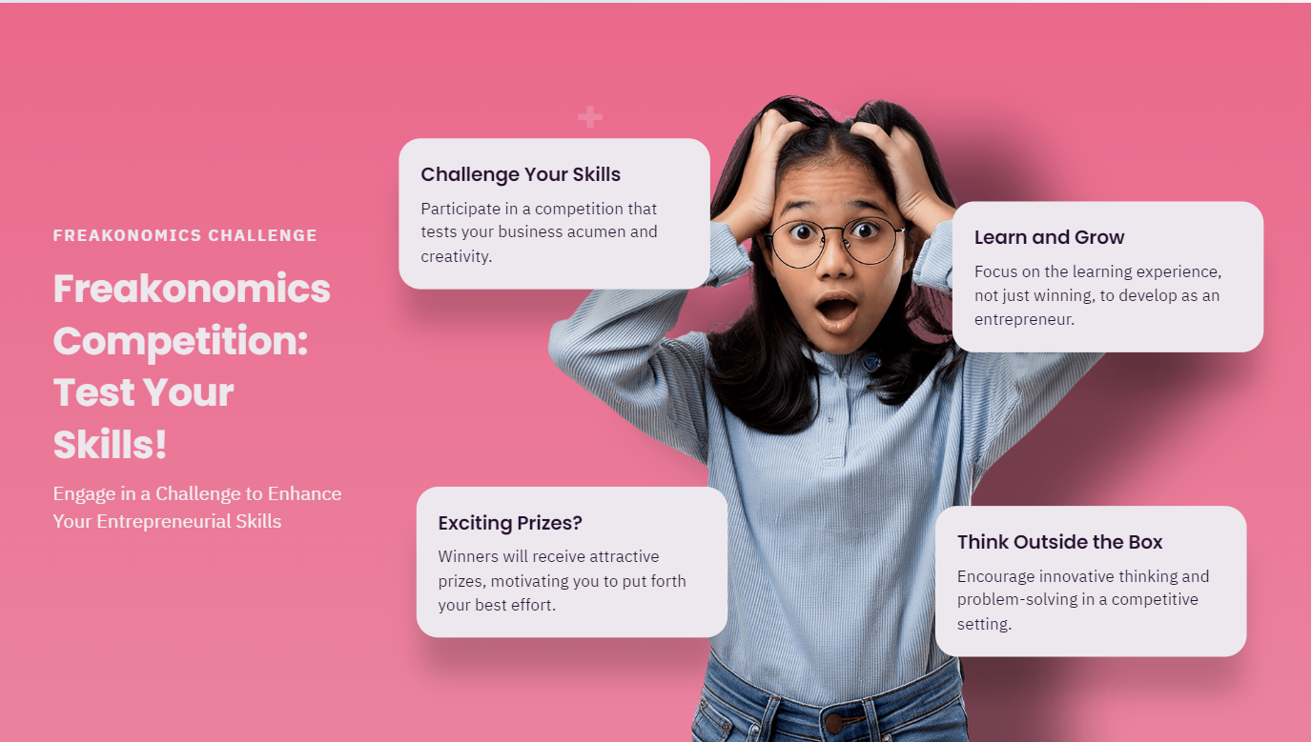

Slide 31
